Slide 1
STM32 – USART
Prof. Federica Villa

Slide 2
USART
Universal Synchronous and Asynchronous Receiver-Transmitter
=
type of a serial interface device that can be programmed to communicate asynchronously or synchronously.
COM ports provide a convenient way for PCs and embedded systems to exchange information. The traditional COM port on a PC is an RS-232 serial port. Recent PCs often skip RS-232 in favor of USB. Nevertheless a USB device can appear as a virtual COM port that applications can access using COM-port APIs or libraries.
Many existing devices with asynchronous serial ports can use a USB UART to communicate with PCs as a virtual COM.

Slide 3
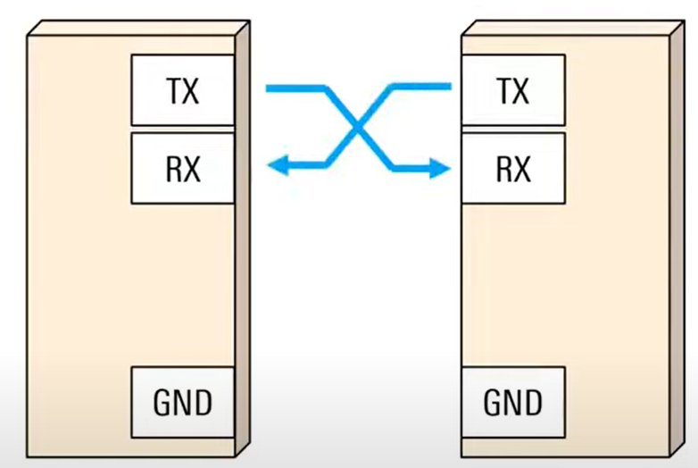
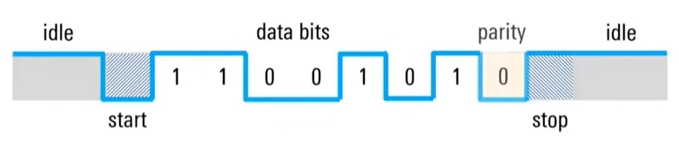
What is UART?
Protocol for exchanging serial data between two devices
Uses only 2 wires: TX → RX, in each direction, plus a common ground
Transmitter and receiver do not share a common clock: they must agree on the speed (Baud rate) and parameters of the transmission
Data is transmitted as “frames”:
Start/stop bits
Data bits (5 to 9, usually 7 or 8, sent LSB first)
Parity bit (optional) useful for error detection: Even parity: ‘1’ if number of ‘1’ is even / Odd parity: ‘1’ if number of ‘1’ is odd.

Slide 4
UART HAL functions
There are many HAL functions for UART.
Basics functions:
HAL_StatusTypeDef HAL_UART_Receive(UART_HandleTypeDef *huart, uint8_t *pData, uint16_t Size, uint32_t Timeout)
HAL_StatusTypeDef HAL_UART_Transmit(UART_HandleTypeDef *huart, uint8_t *pData,
uint16_t Size, uint32_t Timeout)
Direct Memory Access functions:
HAL_StatusTypeDef HAL_UART_Receive_DMA(UART_HandleTypeDef *huart, uint8_t *pData, uint16_t Size)
HAL_StatusTypeDef HAL_UART_Transmit_DMA(UART_HandleTypeDef *huart, uint8_t *pData,
uint16_t Size)

Slide 5
Project
Objective of this project is send information from the microcontroller to the PC, using the USART interface for the Virtual COM.
You will send a string containing your name and your year of birth followed by a new line every one second.
For receiving the string we will use a terminal emulator (PuTTY).
You can download PuTTY here: https://www.putty.org/

Slide 6
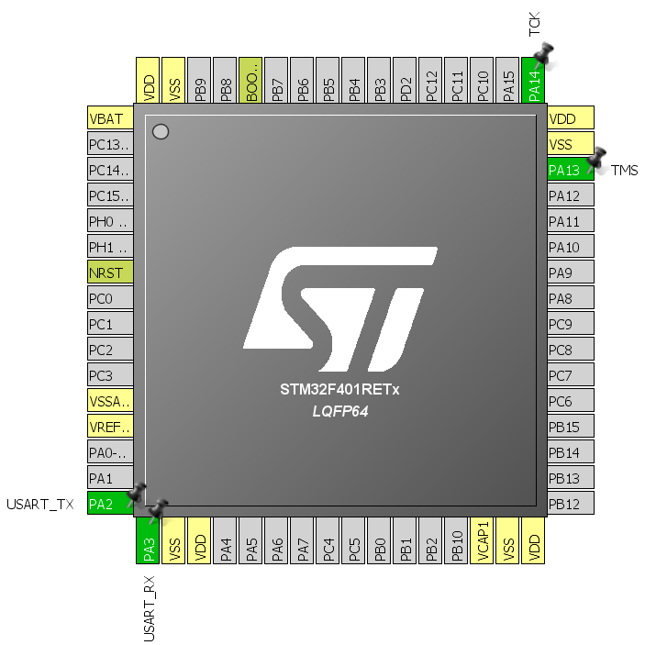
CUBE project Pinout
Open a new project (use default)
Check that the two pins for USART are enabled

Slide 7
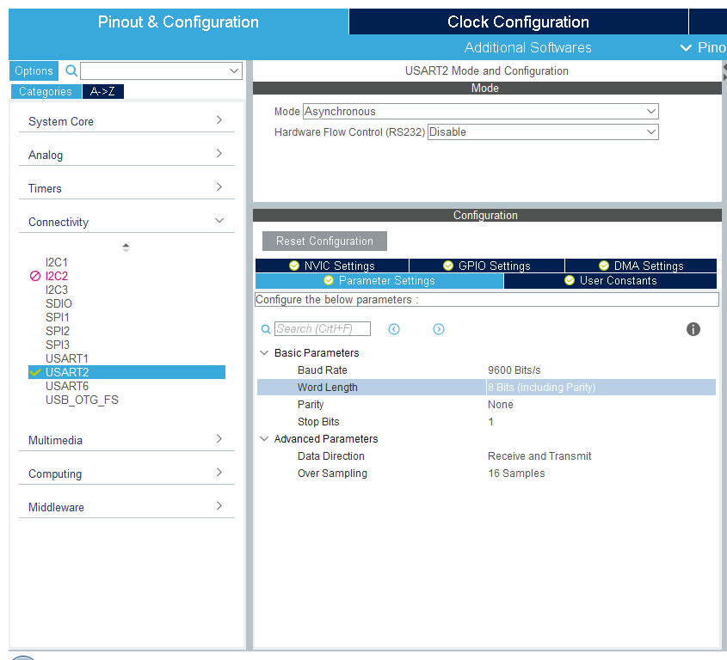
USART configuration
Select a Baud Rate (e.g. 115200 Bits/s). The same BR should be set in PuTTY, since it is an asynchronous communication!

Slide 8
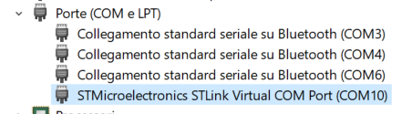
Identify the COM port on your PC
Open “Device Manager” (Gestione dispositivi) by right-clicking on the start menu, and selecting “Device Manager”
Scroll down until “Ports (COM and LPT)” and open the submenu. The COM port we need should be identified by the name “STMicroelectronics STLink Virtual COM Port (COM__)”

Slide 9
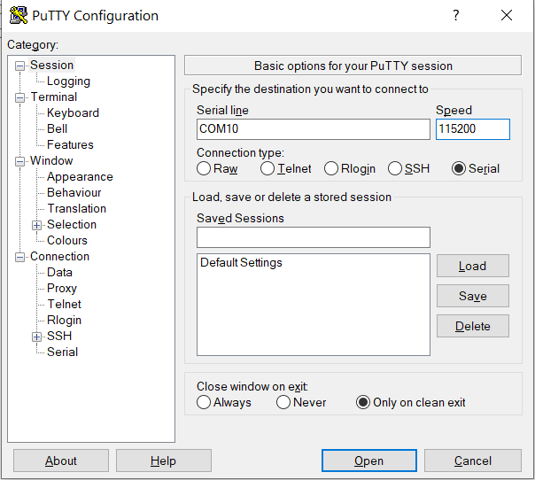
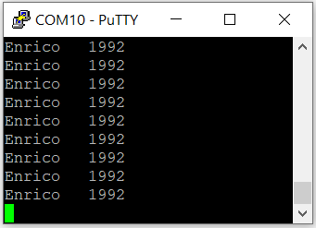
Debug
Start PuTTY to receive data, use it as “Serial” and type the COM reserved on your pc to the STM32. Select the same speed you used for the UART.
Compile and debug you code.
This is the output you should see:

Slide 10
Project - DMA
Repeat the previous project, using DMA functions

Slide 11
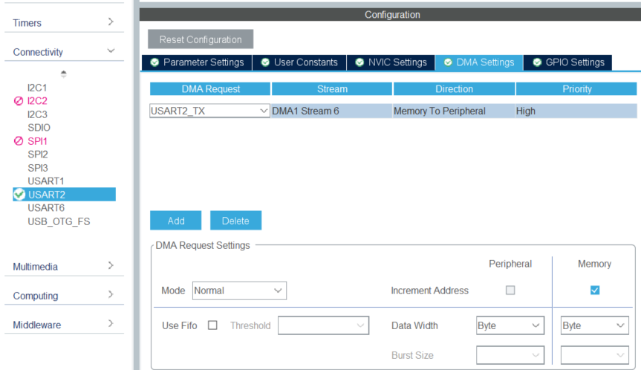
Project – DMA: Setup
Enable DMA in the USART2 peripheral with USART2_TX requests, in normal mode

Slide 12
Project - DMA
Known issues and workarounds:
The UART initialization in DMA mode is bugged and simply calling the HAL_UART_Transmit_DMA() function yields a non-working code!
Solution:
Enable USART2 global interrupts in the NVIC
Manually call the MX_DMA_Init() function BEFORE MX_USART2_UART_Init(). You can make use of the SysInit user code space:
/* USER CODE BEGIN SysInit */
MX_DMA_Init();
/* USER CODE END SysInit */

Slide 13
Conclusion
We will reuse the same code in the next project in which we will send the ADC result through the Virtual COM and display it to PuTTY terminal.
The output of an ADC conversion is a uint32_t variable.

